Slide 1
Survey on skills supply and needs – where do we go?
Klara Insulander Björk, research unit, SSM

Slide 2
Audience interaction
I’ll ask you a question, please respond with a gesture…
Have you heard about SSM:s work with national skills supply and needs (”nationell kompetensförsörjning”) before?
✊
🖐️
✌️
No
Yes, and I wonder if I will ever see any results of it
Yes, and there seems to be some promising progress

Slide 3
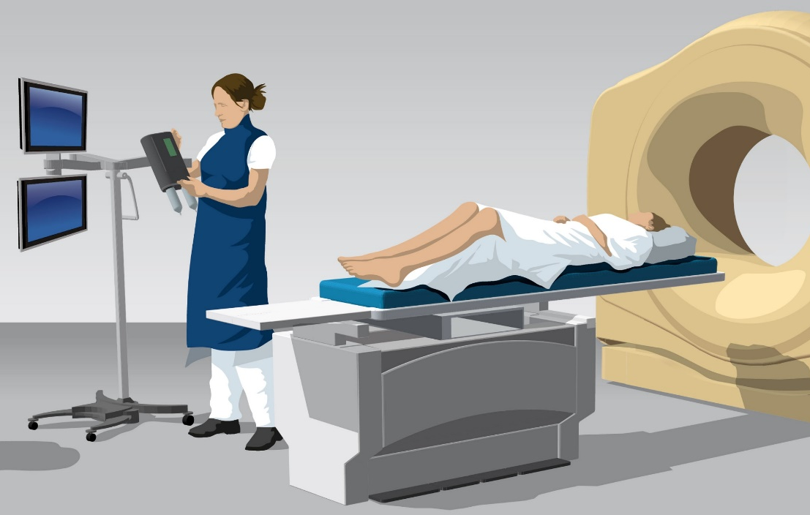
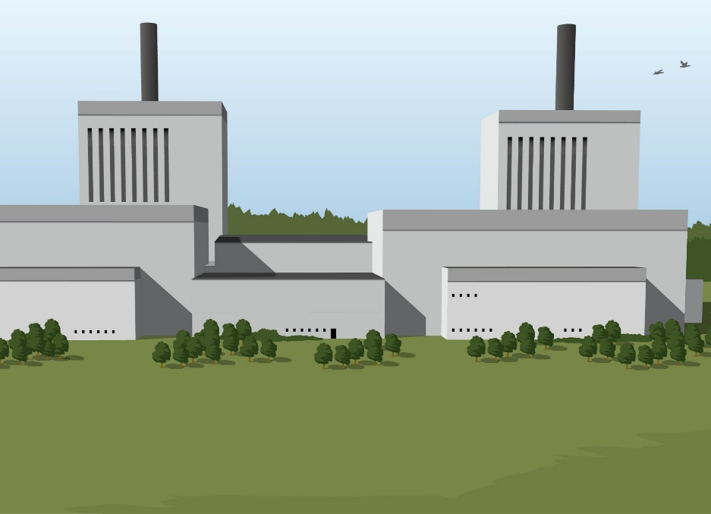
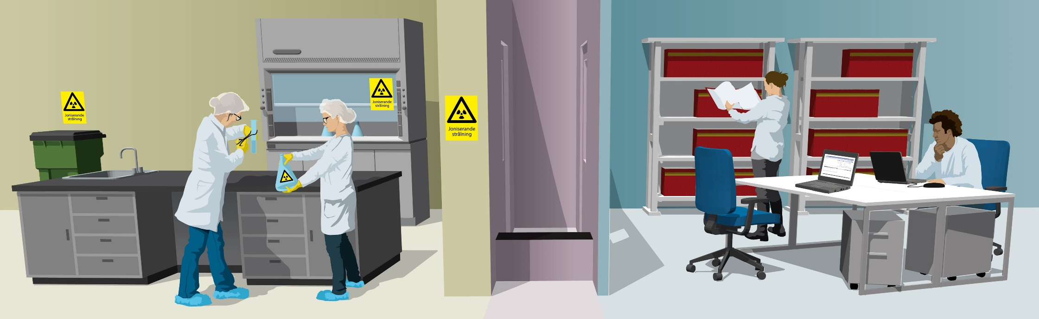
Tasks related to national skills supply
Instruction in the regulation (förordningen) 2008:452
  ”SSM shall contribute to the development of national skills
  […] within the agency’s area of responsibility.”
  ”The authority shall therefore take initiatives for research,
  education, and studies.”
  Areas of responsibility: Nuclear power, healthcare, etc.
Government
assignments
  2018, 2020, 2023, 2024
  Directed towards nuclear
  power, especially lately
Notes:
Uppenbart att det här är två forskare även om deras labb är helt orimligt välstädat, och jag tycker att om de ska slabba med radioaktiva vätskor i en e-kolv så tycker jag att de borde hålla sig i dragskåpet som skymtas i bakgrunden. Det här är antagligen en konstnärlig tolkning av forskning.

Slide 4



National skills supply - goals
Long-term goal: A sufficient number of individuals with radiation safety–related competence to ensure that all activities are conducted safely
  Sub-goals:
  Overview of competence needs and educational capacity
  Adapted educational capacity
  Interest in studies and work within radiation safety
Prerequisite 1: Viable research environments
Prerequisite 2: Collaboration between stakeholders
Notes:
-Vi kan hjälpa till att skapa livskraftiga forskningsmiljöer m.h.a. våra forskningsanslag så som Per förklarade, och även Energimyndigheten och Vetenskapsrådet har ju fått förutsättningar att bidra starkt
-Samverkan: Akademin, andra myndigheter som FOI, MSB, Energimyndigheten, industrin, konsultföretag, RISE mm

Slide 5
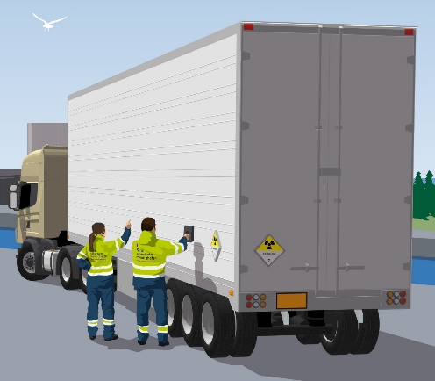
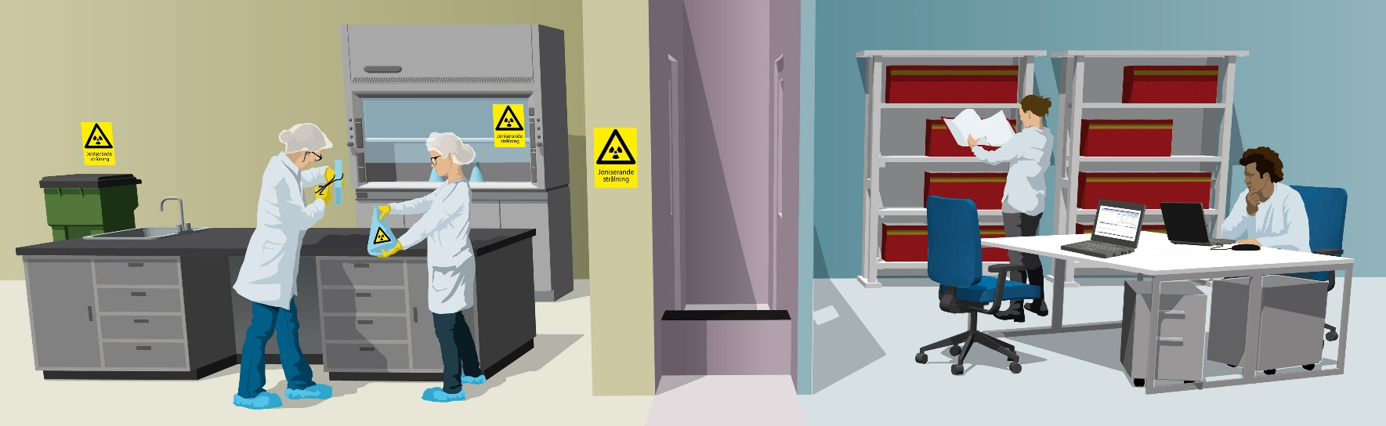
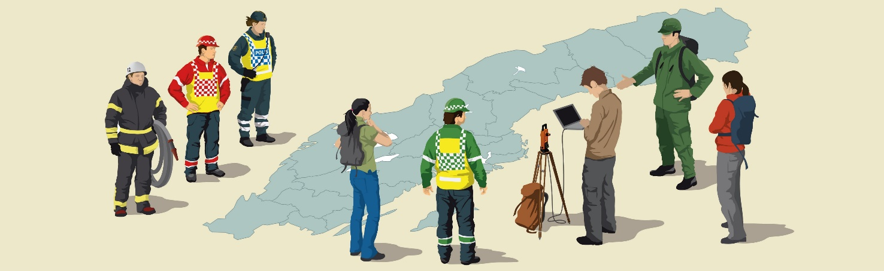





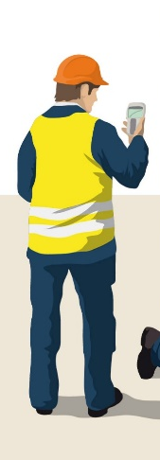
Mapping of competence needs
Only radiation related competence needs (not welders, cleaning personnel etc.)
Competence needs within all sectors
  Nuclear power
  Medicine
  Others
Competence needs today and in 3 and 10 years’ time, taking into account:
  Different scenarios (for the nuclear power sector)
  Competence area (several in each sector)
  Educational level
Survey sent out to 568 stakeholders (34 within nuclear power)
Notes:
Lägg till apropå antalet aktörer att MSB, FOI, Försvarsmakten och Polismyndigheten inte svarat då de betraktar informationen som potentiellt säkerhetskänslig.
(Många små verksamheter, typ veterinärkliniker med en strålskyddsanvarig)
Kunskapsunderlaget är inhämtat men analys och rapportering pågår fortfarande

Slide 6



Educational capacity
Educational capacity within radiation related areas
Available educational pathways
  Academic programs
    Specialised programs
    General programs with a possiblity to specialise
  Contract education
  Vocational (Yh) training programs
Number of admitted and graduated students
Conditions and needs for adapting educational capacity
Statistics from Statistics Sweden (SCB) as well as qualitative interviews with the higher education institutions

Slide 7
Mapping of competence supply and needs
Need to employ about 200 people already within three years, in the base scenario
Increase to 2100 people within 3 years (+ ~30%) and 2300 within 10 years (+~50%)
Today
Increased needs
Replacements
Workforce today
years
years
years
years
years
years
Base scenario – no changes
Life extensions and power uprates
Nuclear new-build
Notes:
Nu måste vi ju understryka att de här siffrorna är väldigt osäkra. Det bygger på många olika aktörers osäkra uppskattningar, och de har ju också varit tydliga med att detta bygger på vissa antaganden som kan stämma eller inte. Man har ju inte bestämt sig för om det är SMR eller storskaliga reaktorer som ska byggas. Men vi ser ju att vi redan nu måste börja bygga upp kompetensen
De starkt färgade staplarna här visar hur mycket arbetsstyrkan kommer att behöva öka. Utöver det så behöver man ju också ersätta personal som går i pension eller slutar av andra skäl, och det behovet visas i de här ljusare staplarna ovanpå.

Slide 8
What is your spontaneous reaction?
✊
🖐️
✌️
That must be an underestimate
Just about what I expected
That must be an overestimate

Slide 9
Needs in specific subject areas (3 years, new-build)
”Other technology” (267): Technical competences related to e.g. IT, I&C, construction
Radiation protection (178): Operative radiation protection, radiation protection regulations, dosimetry, environmental radiology, radioecology
Competences with non-technical elements (149): Management, PSA, MTO-issues, nuclear security, nuclear non-proliferation
Nuclear power technology (95): Nuclear fuels,
reactor physics, nuclear physics, reactor safety,
radiation effects in materials
Radioactive waste (73): Clearance, spent fuel,
other radioactive waste, decontamination
Chemistry (45): Nuclear chemistry, severe
accident chemistry, radioanalytical chemistry
Other technology
Radiation protection
Non-technical
Nuclear power tech
Radioactive waste
Chemistry
Notes:
Totalsummor om det finns, och isf endast 3 år

Slide 10
Educational level and specialisation
The majority has an academic degree
Just under a third has an education specific to a radiation related area
Question: ”Would you, if possible, to a larger extent than today recruit people with an academic degree specific to a radiation related area?”
Yes, definitely
Yes, probably
No, we would recruit as today
Don’t know
PhD, radiation
MSc etc., radiation
Other, radiation
PhD, other
MSc etc., other
Other, other
No post-secondary
Don’t know
Notes:
Akademisk utbildning: Det är de mörkaste lila och gula sektorerna
En knapp tredjedel: Det är de här lila sektorerna

Slide 11

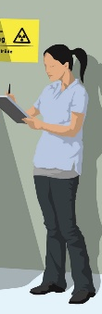
How do we meet the needs?
Preliminary conclusions and draft proposals!
Workshop with relevant stakeholders for discussion on October 24
“Other technology” (267):
  Existing technical programs + specialised courses
  Continuing education courses (fortbildningskurser)
  Key issue: Teaching capacity and competition with other fields. How to attract?
Radiation protection (178) – the largest fully specialised area!
  Practice-oriented in-house training in operational radiation protection
  Vocational college (Yh) or bachelor of engineering program?
  Strengthening/specialisation of the medical physicist program
  Competence needs in radioecology are often highly specialised - PhD
Notes:
-Valbara kurser: Finns ett fåtal på både Chalmers och KTH. Behöver utveckla kursutbudet i samråd med industrin!
-Fortbildningskurser: Chalmers, UU (NANSS), KTH? Samma kommentar som ovan.
-Sjukhusfysiker: Uppfyller idag (typ) behovet i vården. Blir lite kris om industrin tar dem.
-Kompetensbehov inom Radioekologi finns även i beredskapssektorn
-MSc i Radioekologi finns i Norge

Slide 12
How do we meet the needs?
Competences with non-technical elements (149)
  Existing programs + specialised courses
  Separate study within nuclear security
  Non-proliferation and nuclear material control – part of a course – greater need?
Nuclear technology (95)
  MSc program at KTH can graduate 50/year, ~ 30 remain in the country
  Bachelor of Engineering program at UU, capacity ~ 30/year
Waste management (73)
  Operational: Vocational college program?
  Theoretical/academic: Broad field (geology, hydrology, etc.) + specialised courses?
Chemical engineering (45)
  Small numbers, but only a few courses available
  Also in demand within healthcare and emergency preparedness
Notes:
-Dessa kurser saknas till stora delar
-T.ex. Civ.ing. i risk, säkerhet och krishantering vid LU – ny specialisering?
-Icke-spridning och kärnämneskontroll – liten del i kurs i kärnkraftteknik vid UU
-Finansieringen oklar för UU-utbildningen
-Vi får inte glömma att nya lösningar för avfall kommer att behövas vid kärnkraftsutbyggnad!
-Utbildning i kärn-/radiokemi kräver även strålskyddskompetens – bra kombination?

Slide 13
Do these suggestions make sense to you?
✊
🖐️
✌️
No, but I don’t have any better suggestions
No, and I have better suggestions
Yes, that makes sense in general.

Slide 14

An updated proposal to the government
Meeting with a broad panel of stakeholders (”Samverkansplattformen”)
Daniel Westlén: ”Just specify your needs and we’ll see what we can do”
Previous product of the meetings with this panel: Proposal for a national
strategic direction for Sweden’s skills supply in the field of radiation safety
  Submitted to the government early 2022
  Not formally adopted by the government
  Specifically requested by the IRRS (IAEA review)
  Needs to be updated (change of government, nuclear outlook, security situation etc.)
An updated version could be
  What the IRRS requests
  What the government needs to see to take action

Slide 15
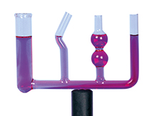


Other conclusions
Competence is transferable between sectors (nuclear power, healthcare, other)
Recruitment of foreign labor is challenging because of requirements for Swedish language skills and security clearance, and high demand also in other countries
Few qualified Swedish applicants for research positions
Research funding allocated as project grants does not automatically give more education
Higher education institutions generally prioritise large student groups
Vocational college programs are lacking but should be able to meet certain needs
Awareness of and interest in the field need to be increased – but how, and by whom?
💸
Notes:
d.v.s. akademisk utbildning bedriv på sätt och vis utifrån en marknadslogik som aldrig kommer att kunna lösa kompetensbehoven inom ett litet område

Slide 16
Summary
Great need for competence reinforcement
The radiation safety field is societally critical but relatively small
The need for competence exceeds the current educational capacity
Parts of the need can be met through specialised courses for professionals or for students in more general programs
For example, radiation protection, nuclear chemistry, and radioecology require extra focus
Notes:
Med ”relativt litet” menar jag att det är mindre än t.ex. behovet av elektroingenjörer. Här utbildar vi ju flera hundra varje år.

Slide 17
Thank you for your attention!

